Slide 1

Ecommerce in Australia
Data Analytics Bootcamp Project 3

Slide 2
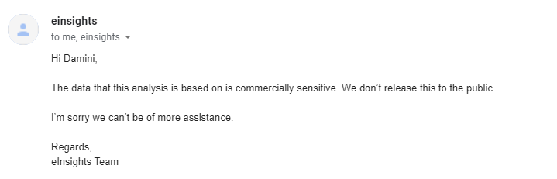
Step 1: Data Sourcing
Australia Post:
Australian Bureau of Statistics (ABS)

Slide 3
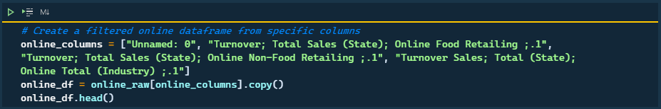

Step 2.1: Playing with Data & Transformation
Raw Data files were loaded into Tableau
Visualised data that would create a data story

Slide 4
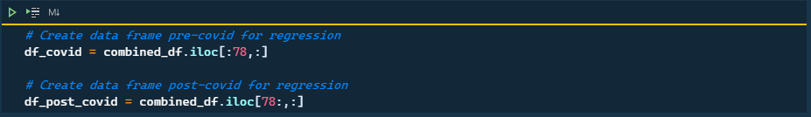
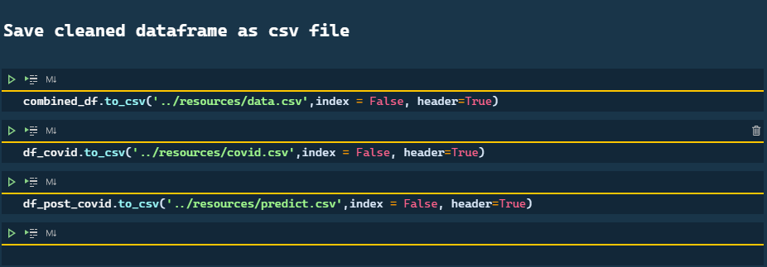

Slide 5


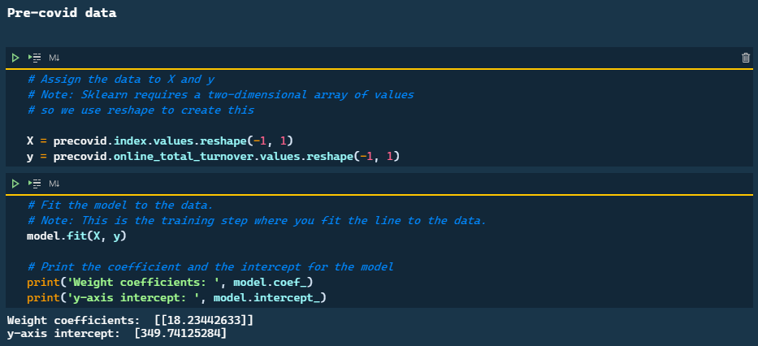
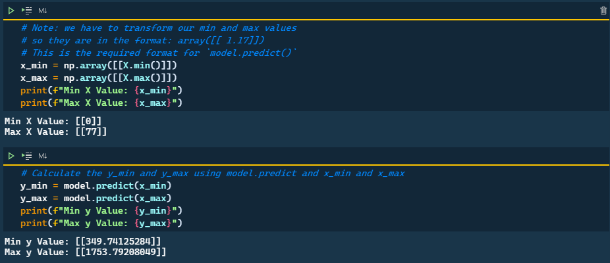
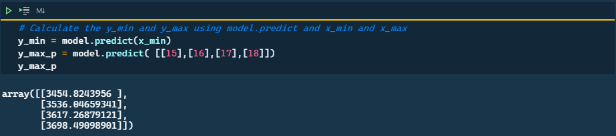
Step 2.2: Machine Learning

Slide 6
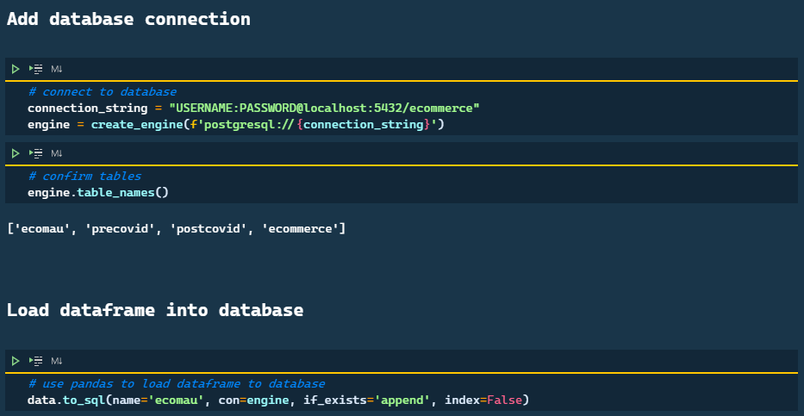
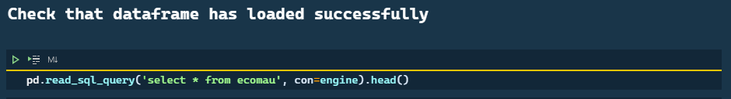
Step 2.3: Load data into PostgreSQL

Slide 7
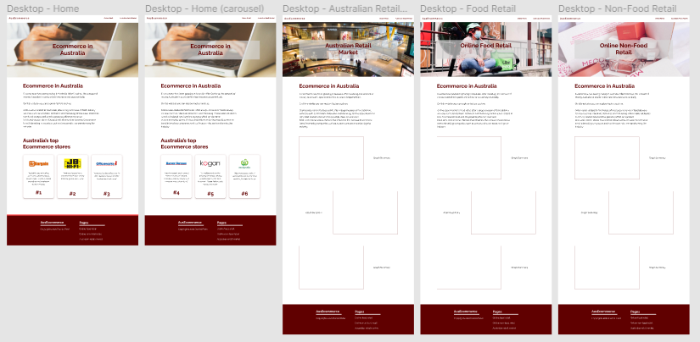
Step 5: HTML & CSS
Figma

Slide 8
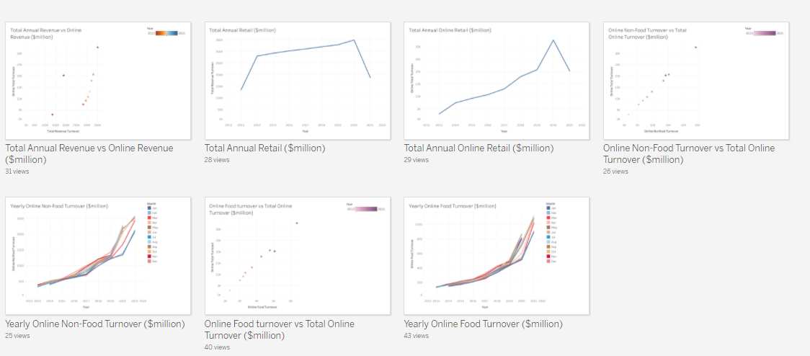
Step 6: Data Visualisation
Tableau Public

Slide 9
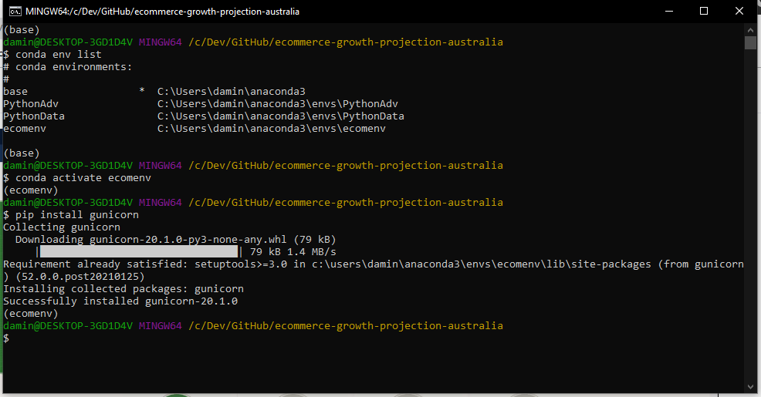
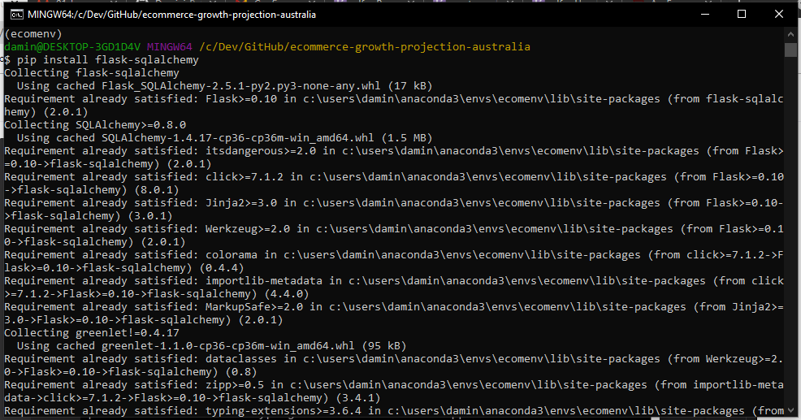
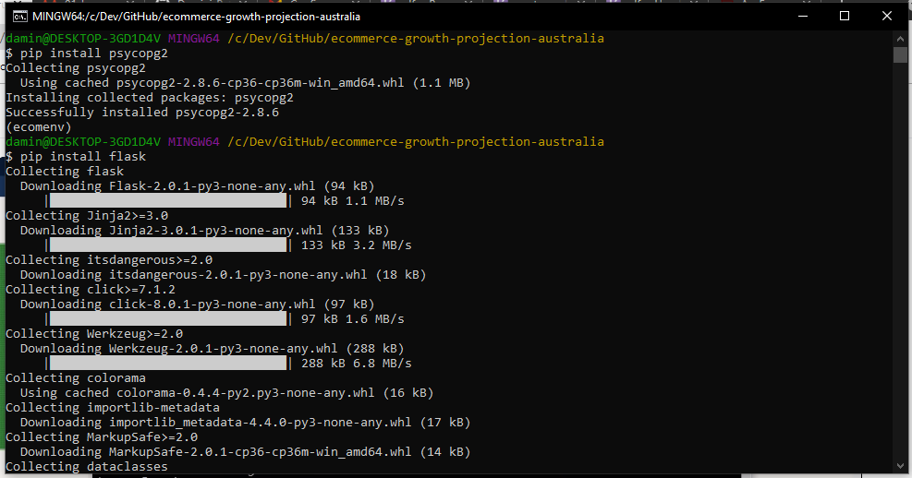
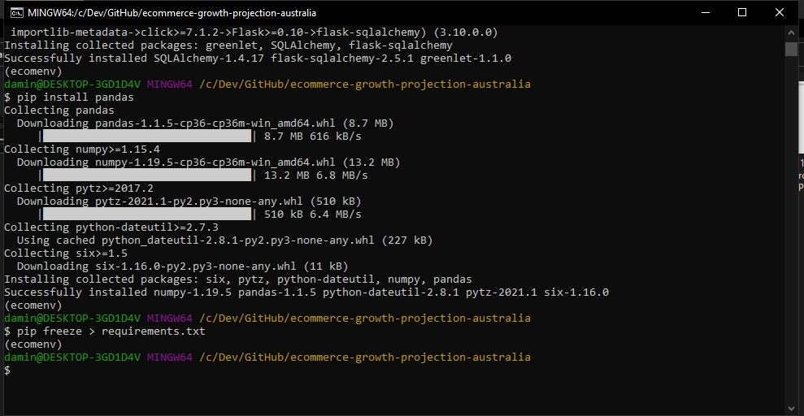
Step 7: Heroku Deployment

Slide 10
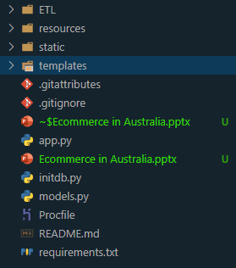
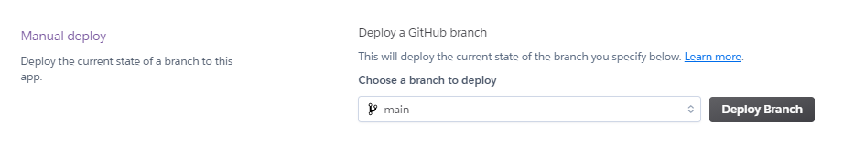
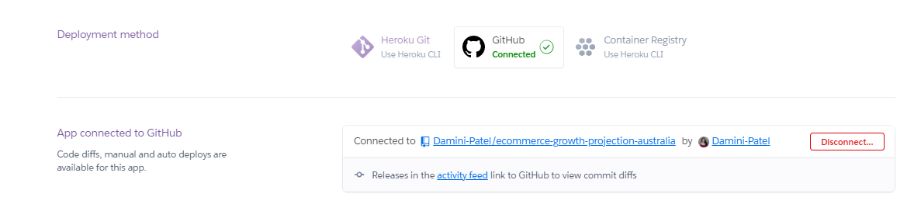
1. Make sure file structure is correct
3. Launch the main branch…
2. Link Heroku to correct GitHub repository

Slide 11
Questions?

